Slide 1

Text Summarization with
Pretrained Encoders
AI 2-2팀
한건수 연구원
2019. 9. 19
Copyright© 2018 TmaxData. All Rights Reserved.

Slide 2

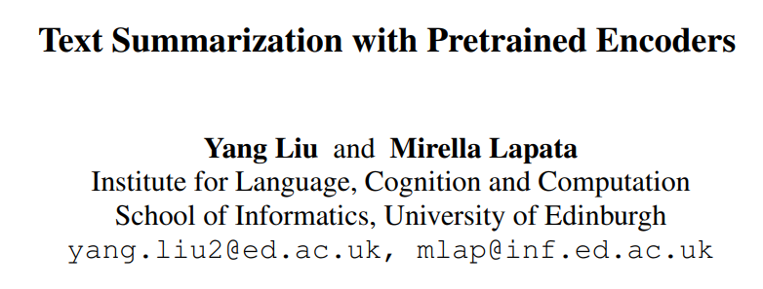
Papers
+ Abstractive

Slide 3

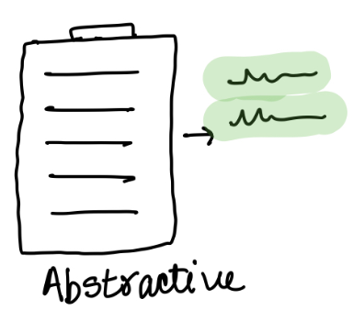
Summarization
Extractive
Copying and concatenating the most important spans in a document
Spans are usually sentences
Some Ext. summarization tasks aim to extract words
Binary Classification Task
Abstractive
Generating few sentences that captures the important ideas of a document
Summary may include unseens words
Seq2Seq Task

Slide 4
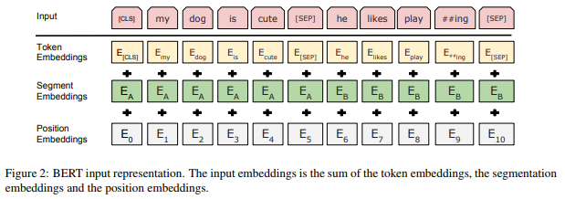
Need for Modification
To use BERT for Extractive Summarization (ES),
We need representation for each sentence
However, BERT gives output vectors at word-level
Yes ! There is a segment embedding → BUT only has two labels (sent A and sent B)
ES often involves more than two sentences
→ Modify input sequence and embeddings for BERT

Slide 5
Need for Modification
To use BERT for Extractive Summarization (ES),
We need representation for each sentence
However, BERT gives output vectors at word-level
Yes ! There is a segment embedding → BUT only has two labels (sent A and sent B)
ES often involves more than two sentences
→ Modify input sequence and embeddings for BERT

Slide 6
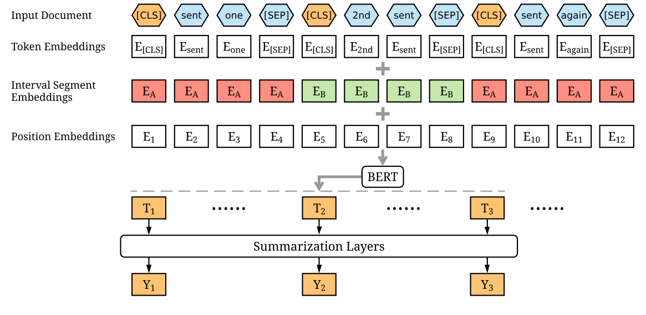
Model Architecture

Slide 7
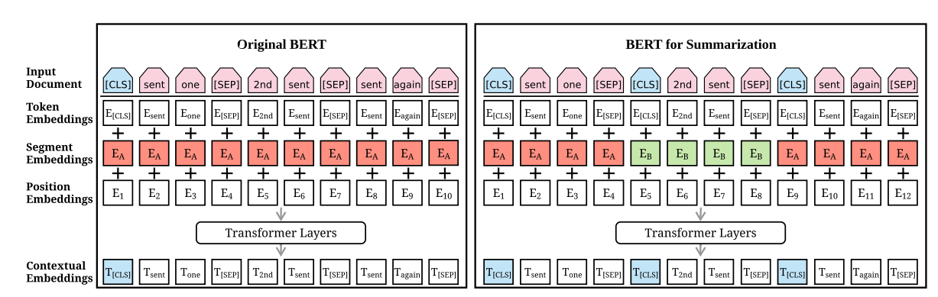
Model Architecture

Slide 8
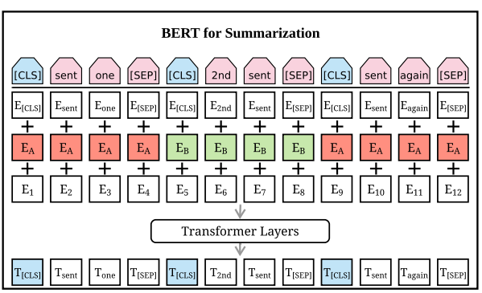

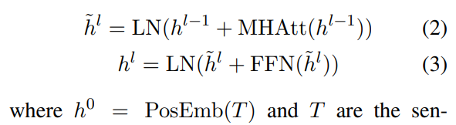
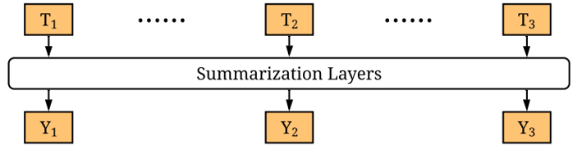



Extractive Summarization Layers
1. Simple Classifier
Predicted score for each $T_{i}$
.
And calculate cross entropy with $Y_{i} ∈\left\{0,1\right\}$
LSTM + Simple Classifier
Inter-sentence Transformer + Simple Classifier
Apply Transformer layers $l times$
And calculate cross entropy with $Y_{i} ∈\left\{0,1\right\}$
BERT and summarization layers are jointly fine-tuned
$${T=T}_{1}{, T}_{2},T_{3}…$$

Slide 9

Abstractive Summarization Layers
Abstractive
Summary
Input
Document
Encoder
Pre-trained BertSum
Decoder
6-layerd Transformer
(initialized randomly)
Different learning rates are used because the decoder is not pre-trained

Slide 10
Two-Stage Fine-tuning
Propose a two-stage fine-tuning
First fine-tune the encoder on extractive summarization task
Then fine-tune it on abstractive summarization task
This results in an improved performance

Slide 11
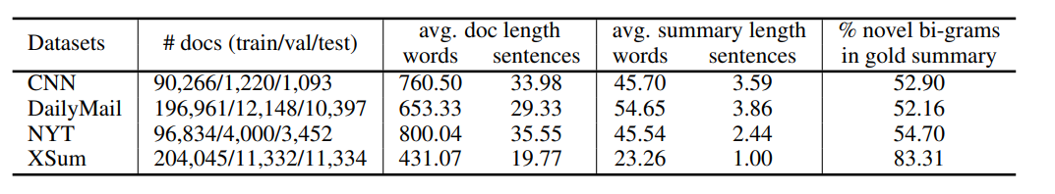
Data
Highly abstractive
CNN/Daily Mail
News articles and associated highlights
New York Times (NYT)
News articles
Documents with summaries less than 50 words removed
XSum
News articles with one-sentence summary

Slide 12
Implementation
Extractive
Use greedy algorithm to obtain extractive summary from abstractive summary
Top – 3 sentences as the summary
Abstractive
During decoding, beam search with size 5 is used

Slide 13
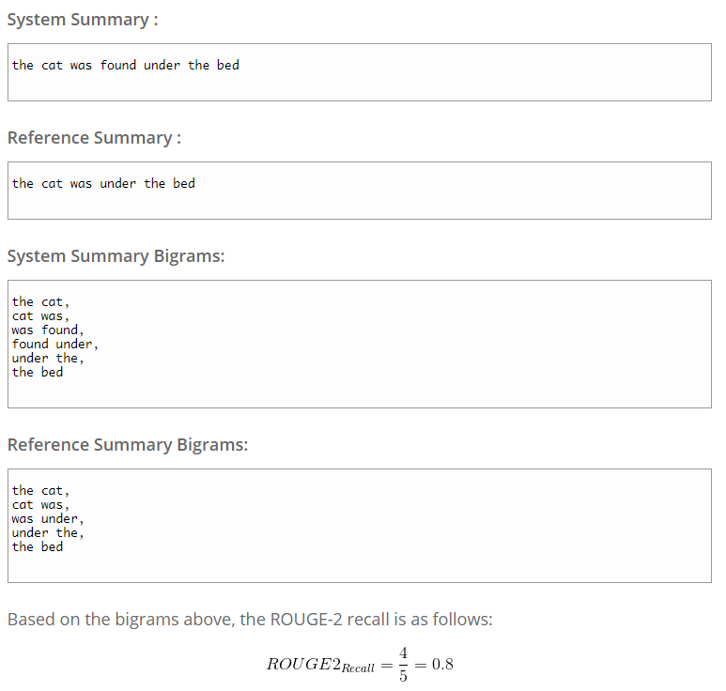
ROUGE Score

Slide 14
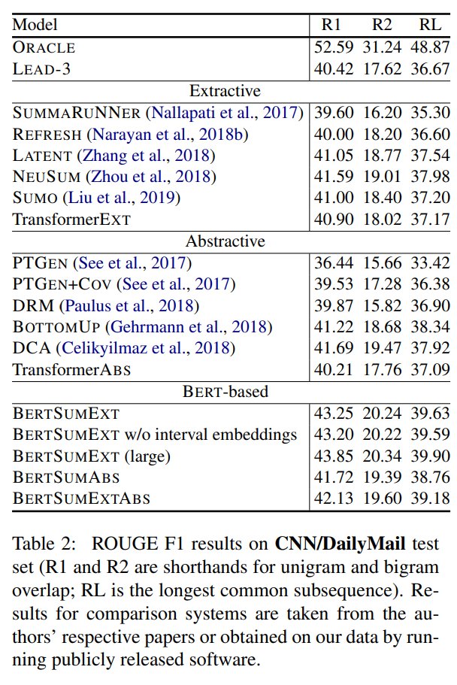
Result – CNN/DailyMail
Among 50 checkpoints, average of top-3 for validation loss
Always first three sentences of a document

Slide 15
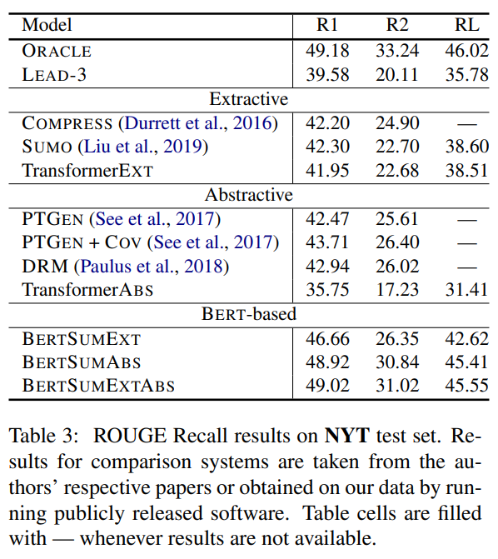
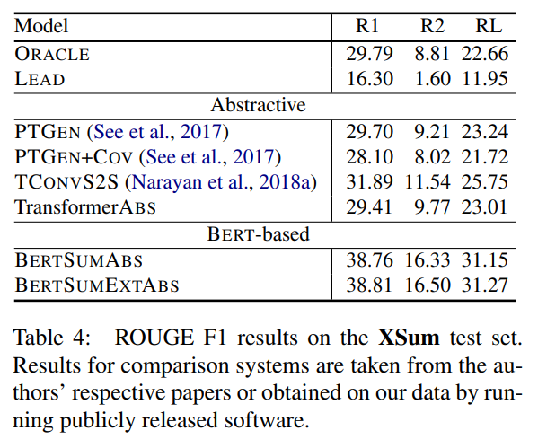
Result – NYT/XSum

Slide 16
Human Evaluation
Document
Extractive
Summary
Answerable
Questions

Slide 17
Human Evaluation
Document
Extractive
Summary
Answerable
Questions
Predicted
Extractive
Summary
Answerable
Questions
Document

Slide 18
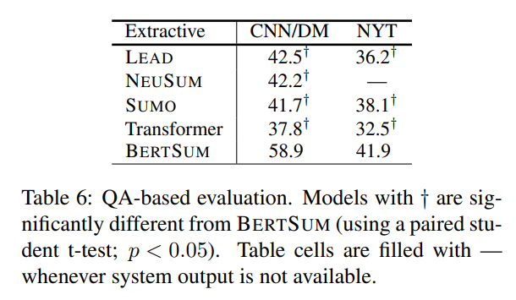
Human Evaluation
Predicted
Extractive
Summary
Answerable
Questions

Slide 19
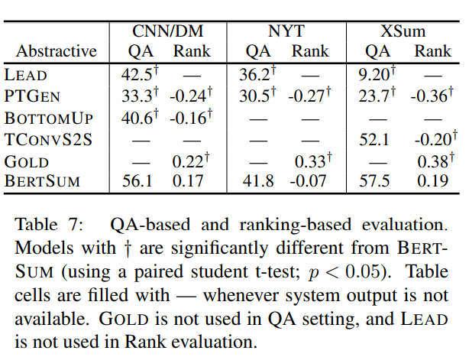
Human Evaluation
Examine
Informativeness, Fluency and Succinctness

Slide 20

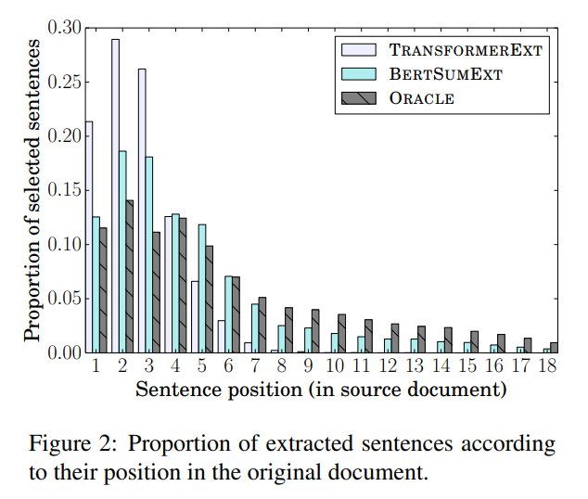
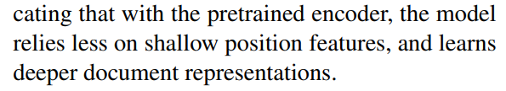
Analysis

Slide 21
Q & A

